Slide 1
Time-varying Weathering in Texture Space
Mid Evaluation
Mohee Datta Gupta: 2018112005
Mohsin Mamoon Hafiz: 2018101029
Shivansh: 2018102007
Srivathsan Baskaran: 2018101049

Slide 2
Given an input image of a weathered texture, our project aims to synthesize a series of textures emulating a weathering and de-weathering processes, yielding a time-varying texture.
OBJECTIVE

Slide 3
Introduction
OBJECTIVE: Given an input image of a weathered texture, our project aims to synthesize a series of textures emulating a weathering and de-weathering processes, yielding a time-varying texture.
This would be done by computing an estimated age map of the texture based on the prevalence of similar patches in the texture. Further, using this age map, an intact texture would be generated to achieve the desired results.
To produce de-weathered textures, the age map has to be manipulated to control an interpolation of the intact texture and the input texture. Weathered textures can be synthesized by extrapolating the differences between the input texture and the intact texture.

Slide 4
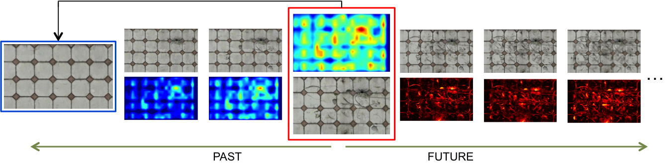
An overview of the method involved
De-Weathered Texture
Generation
Age Map
Creation
Weathered Texture
Generation

Slide 5
There are various Image processing techniques and algorithms involved in the process of texture generation.
The first part of creating an age map involves
Spatial Convolution
Image Gradient
Nearest Neighbour Search
The Intact Texture Generation requires us to find potential tile centers( local minima from age map and further filtering to result in a grid which we can use to do Template Generation.
The concepts involved are :
Convolution
Detecting Regularity
Tile Detection and Texture Reconstruction
The final Weathered textures are constructed by Synthesis of Weathered pixels by distances from age map.

Slide 6
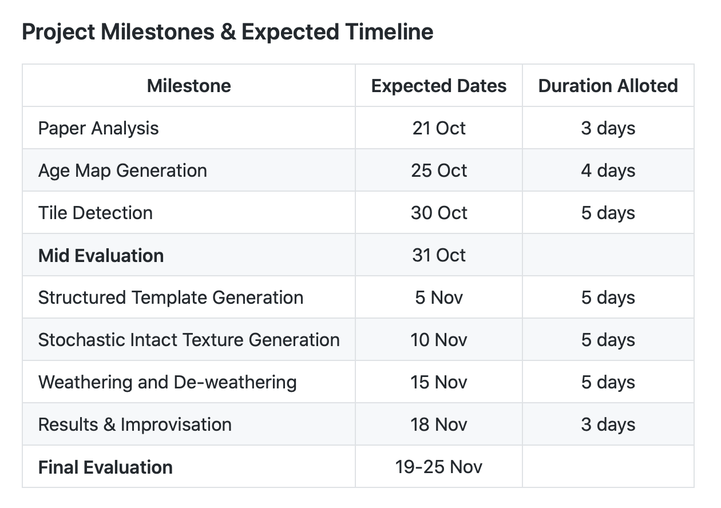
Checkpoints
These are the major components of the project that we have to do.
The expected dates by which we are planning to finish them are mentioned alongside it.

Slide 7

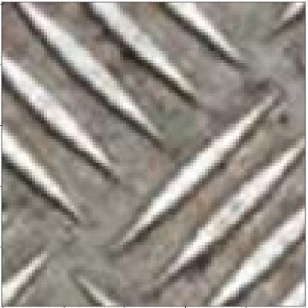
Progress
Distance Function:
We have completed the naive implementation of the Age Map. Currently it is taking a bit more time than expected on a relatively small input image. We are working on optimizing it.
We are currently implementing tile detection and have made some progress. It should be completed shortly.
Source Patch:

Slide 8
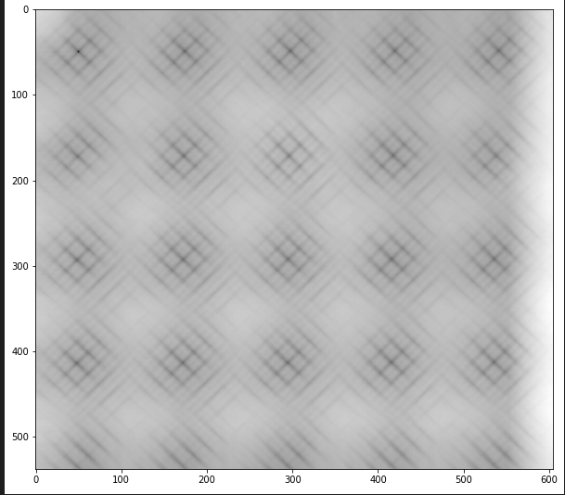
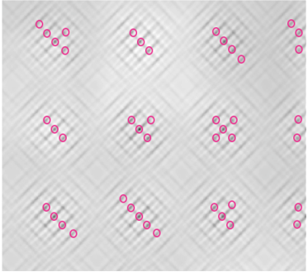
Comparison Of Outputs
Our Output:
We checked our output of distance map (one source patch) with that expected in the paper.
We see that the patterns produced are similar
(This is also used in Tile Detection)
Output of Paper:

Slide 9
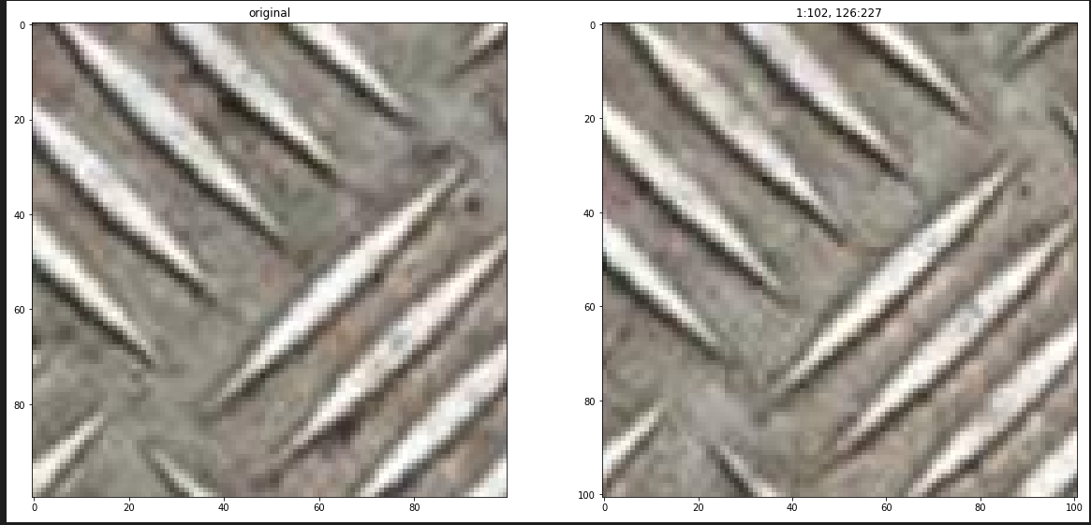
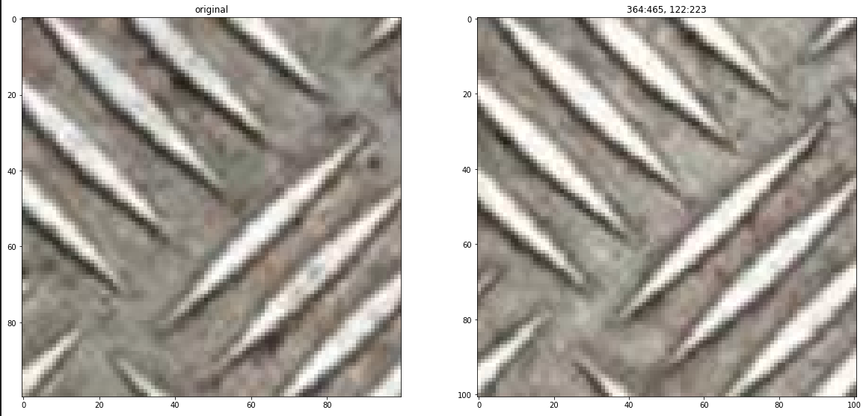
K- Nearest Neighbour
Neighbour 1: [1:102, 126:227]
We took the source patch shown earlier as [0:100, 0:100] ,i.e., N=100
For the K nearest neighbour(in terms of dist between the patches) we are showing 2 of them [K=10]
Neighbour 2: [364:465, 122:223]

Slide 10
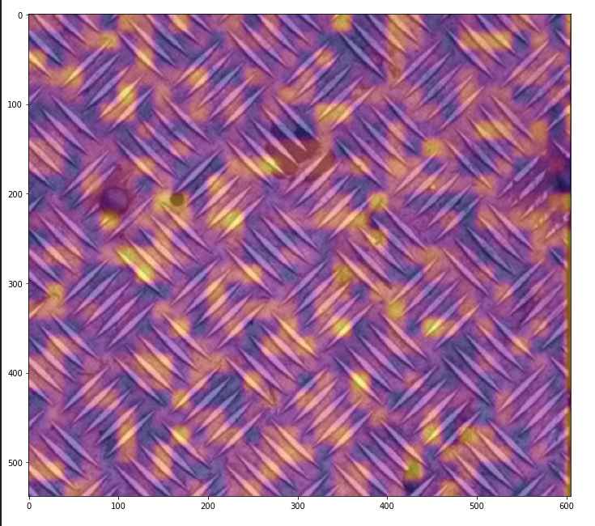
Age Map
Our Age Map Output:
The color map we used is not similar to the one used in the paper and there are still some irregularities in the output which are in the process of correction

